Slide 1
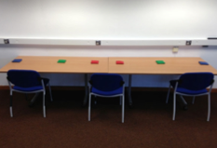
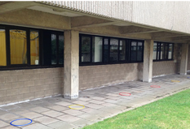

Reaching task
Reaching task
Experiment 1A
Throwing task
Small talk
Reaching task
Experiment 1B
Abstract (text) problems
Throwing task
Arithmetic problems
Throwing task
Throwing task
Reaching task
Experiment 1C
Throwing task
Sodoku
Detection task
Guided practice
Experiment 2
Acuity mapping
Detection task
Unguided practice

